Slide 1
Using the cosine ratio
Trigonometry

Slide 2
How our teaching resources are designed for the classroom

Slide 3
I can use the cosine ratio to find the missing side or angle in a right-angled triangle.

Slide 4
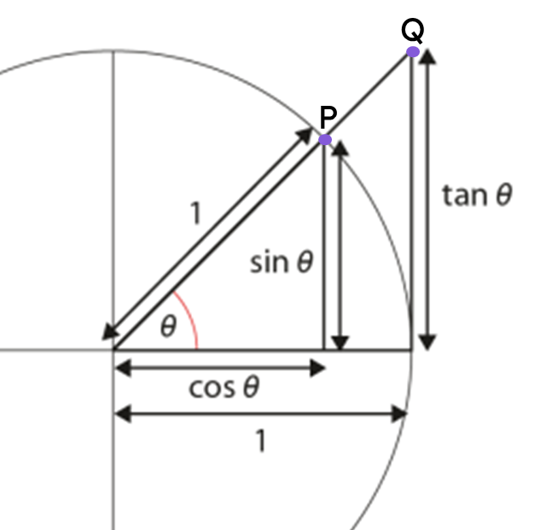
The hypotenuse is the side of a right-angled triangle which is opposite the right angle.
The adjacent side of a right-angled triangle is the side which is next to both the right angle and the marked angle.
Trigonometric functions are commonly defined as ratios of two sides of a right-angled triangle containing the angle.
The cosine of an angle (cos(θ°)) is the x-coordinate of point P on the triangle formed inside the unit circle.

Slide 5

Using the cosine ratio
Formalising the cosine formula
Calculating angles using the cosine formula

Slide 6
Formalising the cosine formula
We know that these two triangles are similar, as two of the angles in one triangle are equal to two angles in the other.
We can find the length of the side labelled x by using a ratio table.
× 0.68
1
0.68
× 15
× 15
15
0.68 × 15
× 15
10.2
× 0.68
15 cm
1 cm
47°
47°
10.2 cm
0.68 cm
x cm

Slide 7
Formalising the cosine formula
We can also generalise this process to any right-angled triangle that has an angle θ°, where the side adjacent to θ° and the right-angle has length cos(θ°).
× cos(θ°)
1
cos(θ°)
× h
× h
h
h × cos(θ°)
× h
adj
× cos(θ°)
h cm
1 cm
θ°
θ°
h × cos(θ°)
cos(θ°)
adj

Slide 8
Formalising the cosine formula
We can also generalise this process to any right-angled triangle that has an angle θ°, where the side adjacent to θ° and the right-angle has length cos(θ°).
h cm
1
cos(θ°)
h
h × cos(θ°)
θ°
× cos(θ°)
adj
h × cos(θ°)
The length of the hypotenuse
multiplied by the cosine of an angle of θ°
equals the length of the side adjacent to that angle and the right-angle.

Slide 9
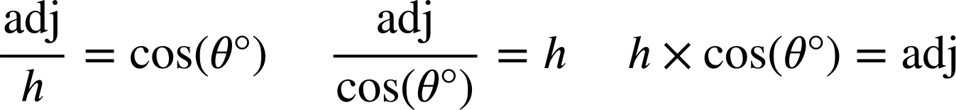
Formalising the cosine formula
We can use this ratio table to generate a formula that shows the relationship between the side adjacent to angle θ° and the hypotenuse, and represent that formula in three ways.
The cosine formula
× cos(θ°)
1
cos(θ°)
cos(θ°)
h cm
× h
× h
÷ h
h
adj
h
adj
θ°
adjacent
× cos(θ°)
÷ cos(θ°)
× cos(θ°)
h × cos(θ°)

Slide 10
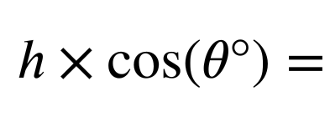
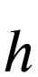
Formalising the cosine formula
We can also derive two versions of the formula given one of the others by performing a division.

Slide 11
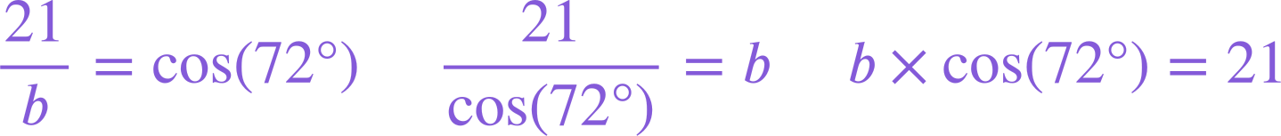
Formalising the cosine formula
We can substitute values in a right-angled triangle into each version of the cosine formula to represent the relationship between the side adjacent to an angle and the hypotenuse in different ways.
b cm
72°
21 cm

Slide 12



Formalising the cosine formula
One correct equation showing the relationship between the hypotenuse and side adjacent to the 38° angle is:
1
cos(θ°)
× 20
× 20
20
adj
× cos(38°)
Which of these also correctly shows the relationship between the hypotenuse and adjacent side of this triangle?
a
20 cm
38°
b
adj

Slide 13
Formalising the cosine formula
Which of these correctly shows the relationship between the hypotenuse and the side adjacent to the 82° angle for this triangle (values are rounded to the nearest integer)?
a
d
100 cm
b
e
82°
c
14 cm

Slide 14
Formalising the cosine formula
Which of these correctly shows the relationship between the hypotenuse and the side adjacent to the angle θ° for this triangle?
a
d
39 cm
b
θ°
e
116 cm
c

Slide 15
Formalising the cosine formula
In each version of the formula, a different part of the triangle is written as the subject.
It is helpful to use the version of the formula whose subject matches the part of the triangle you are trying to find the value of.
hyp
103 cm
57°
103 × cos(57°) = p
p cm
p = 56.098 cm (3 d.p.)
adj
We want to find the value of p, the length of the side adjacent to an angle of 57°.

Slide 16
Formalising the cosine formula
Which of these correctly shows the relationship between the hypotenuse and the side adjacent to the angle of 16° for this triangle (values are rounded to the nearest integer)?
85 m
a
16°
d
b
q cm
e
c

Slide 17
Formalising the cosine formula
Which of these is the correct equation to find the value of q most efficiently?
Hence, find the value of the side labelled q (2 d.p.)
85 m
a
16°
b
q = 88.43
q cm
88.43 cm
d
88.43 cm seems like a sensible answer, since this is the hypotenuse, and so should be greater in length than the side 85 cm.

Slide 18
Formalising the cosine formula
1) Substitute the labelled sides and angle in each triangle into the given version of the cosine formula, and find the length of its missing side.
b cm
× cos( ) =
51°
289
a =
3.5 cm
289 cm
=
cos( )
85°
b =
a cm

Slide 19
Formalising the cosine formula
2) Match the triangle to the equation showing the relationship between its hypotenuse and an adjacent side.
Use the equation to find the length of the missing side labelled x on each triangle (2 d.p.)
c)
a)
b)
53 cm
31 cm
x cm
53°
31°
x cm
53 cm
31°
x cm
53 × cos(31°) = x
d
x × cos(31°) = 53
e
31 × cos(53°) = x
f

Slide 20
Formalising the cosine formula
3) By using the cosine formula, find the length of the missing side labelled with a letter for each of these triangles (2 d.p.)
a)
b)
c)
1 cm
22 cm
22 cm
32°
32°
42°
a cm
b cm
c cm
d)
e)
f)
e cm
f cm
d cm
48°
22 cm
42°
22°
42°
42 cm
22 cm

Slide 21
Formalising the cosine formula
4) Find the lengths of the distances a, b, c, and d
(rounded to the nearest integer).
d cm
18 cm
b cm
37 cm
24°
a cm
11 cm
c cm
5 cm

Slide 22

Formalising the cosine formula
1) Substitute the labelled sides and angle in each triangle into the given version of the cosine formula, and find the length of its missing side.
b cm
× cos( ) =
51°
289
85°
a
a =
3.5 cm
25.19
289 cm
3.5
b
=
cos( )
51°
85°
b =
5.56
a cm

Slide 23
Formalising the cosine formula
2) Match the triangle to the equation showing the relationship between its hypotenuse and an adjacent side.
Use the equation to find the length of the missing side labelled x on each triangle (2 d.p.)
c)
a)
b)
53 cm
31 cm
x cm
53°
31°
x cm
53 cm
31°
x cm
31 × cos(53°) = x
f
53 × cos(31°) = x
d
x × cos(31°) = 53
e
x = 18.66
x = 45.43
x = 61.83
The side adjacent to 53° has a length of 18.66 cm
The side adjacent to 31° has a length of 45.43 cm
The hypotenuse has a length of 61.83 cm

Slide 24
Formalising the cosine formula
3) By using the cosine formula, find the length of the missing side labelled with a letter for each of these triangles (2 d.p.)
a)
b)
c)
1 cm
22 cm
22 cm
32°
32°
42°
a cm
a = 0.85
b cm
b = 18.66
c cm
c = 16.35
d)
e)
f)
e cm
f cm
d cm
48°
22 cm
42°
22°
42°
42 cm
22 cm
d = 29.60
e = 32.88
f = 45.30

Slide 25
Formalising the cosine formula
4) Find the lengths of the distances a, b, c, and d
(rounded to the nearest integer).
5 cm
d cm
18 cm
12 cm
b cm
37 cm
24°
a cm
11 cm
c cm
5 cm
34 cm
16 cm

Slide 26
Using the cosine ratio
Formalising the cosine formula
Calculating angles using the cosine formula

Slide 27
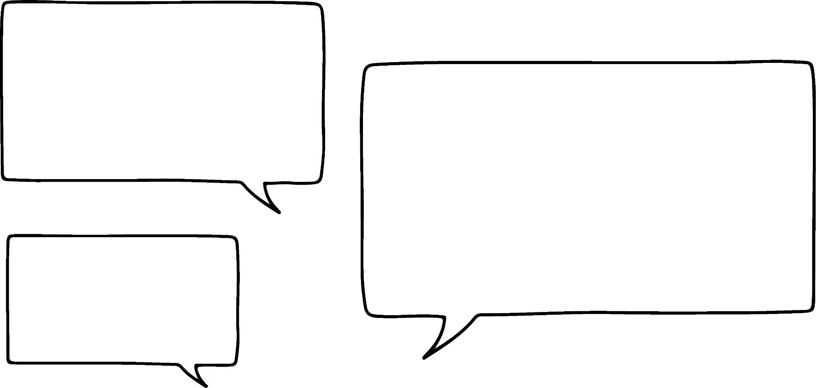


Calculating angles using the cosine formula
I can calculate the length of the side adjacent to 40° because I also know the length of the hypotenuse!
I can calculate the length of the hypotenuse because I also know the length of the side adjacent to 59°.
Izzy
Jacob
6 cm
hyp
59°
3 cm
40°
adj
6 × cos(40°) = adj
3
hyp =
= 5.82
cos(59°)
adj = 4.60

Slide 28
Calculating angles using the cosine formula
But how can we use this other version of the cosine formula to find the angle if we know the lengths of the hypotenuse and the side adjacent to that angle?
23 cm
θ°
13 cm
Jacob
cos(θ°) =
13
≈ 0.565
23
How can you find the size of angle θ°?

Slide 29
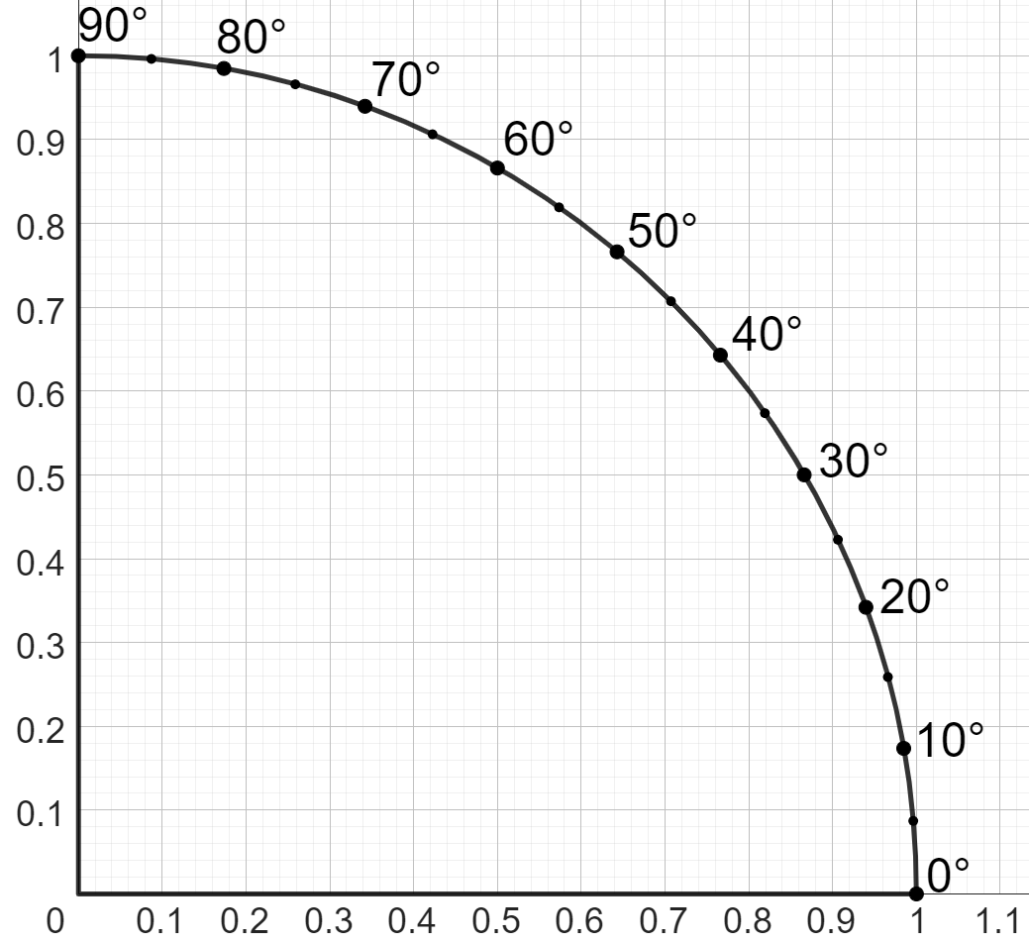
Calculating angles using the cosine formula
On a unit circle, we can find the length of a side adjacent to the angle 30° by applying the cosine function to that angle:
cos( 30° ) =
30°
0.866
angle
length of adjacent side on unit circle
1 unit
The cosine function has an inverse function called the arccosine function (or arccos function).
You may see it as cos⁻¹ on a calculator.
30°
0.866 units

Slide 30
Calculating angles using the cosine formula
On a unit circle, we can find the length of a side adjacent to the angle 30° by applying the cosine function to that angle:
cos( 30° ) =
30°
0.866
arccos
arccos
30°
=
cos⁻¹(0.866)
1 unit
cos⁻¹( 30° ) =
0.866
30°
30°
0.866 units
length of adjacent side on unit circle
angle

Slide 31
Calculating angles using the cosine formula
Finding the cosine of an angle outputs a ratio of the side adjacent to that angle and the hypotenuse.
The inverse function of cosine, the arccos function, takes a ratio of the side adjacent to an angle and the hypotenuse (written as a fraction or decimal), and gives you the size of that angle.
Whilst this ratio is usually written as a decimal (with respect to a hypotenuse of 1), we can interpret this decimal as a set of equivalent fractions:
13
cos⁻¹( 30) =
cos⁻¹( 0.565 ) =
55.6°
23
0.866
1.732
86.6
Adjacent of 13 and hypotenuse of 23.
Or written as a decimal.
cos(30°) =
=
=
1
2
100
23 cm
Adjacent of 86.6 on a triangle with hypotenuse of 100.
Adjacent of 0.866 on a triangle with hypotenuse of 1.
Adjacent of 1.732 on a triangle with hypotenuse of 2.
55.6°
θ°
13 cm

Slide 32
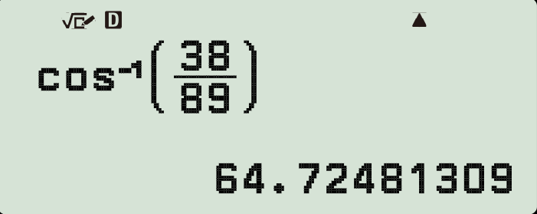
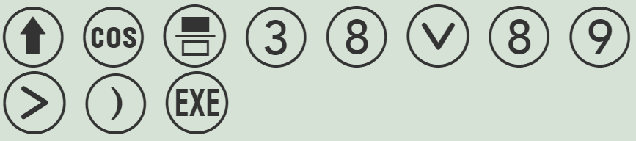
Calculating angles using the cosine formula
We can use the arccos function on a calculator to find an angle.
38
cos⁻¹( )
= 64.7°
89
89 cm
θ°
38 cm
cos(θ°) =
38
89
38
cos⁻¹( )
= θ°
89

Slide 33
Calculating angles using the cosine formula
Which of the following equations are correct when finding the size of angle n° in the equation:
cos(n°) = 0.86?
a
c
b
d

Slide 34
Calculating angles using the cosine formula
Which of these are equivalent to this equation?
cos(n°) = ?
4
9
a
c
b
d

Slide 35
Calculating angles using the cosine formula
Which of the following equations are correct when finding the size of angle u° in this triangle?
a
c
69 cm
b
d
u°
16 cm

Slide 36
Calculating angles using the cosine formula
1) Match each triangle to: an equation that describes the relationship between its hypotenuse and an adjacent side, and to the size of its angle (2 d.p.).
a
b
d
4 cm
e
5 cm
4
cm
θ°
3 cm
θ°
f
3 cm
c
5 cm
θ° = 53.13°
g
θ° = 36.87°
h
3 cm
θ°
θ° = 41.41°
i
4 cm

Slide 37
Calculating angles using the cosine formula
2) Find the size of each angle marked with a letter (1 d.p.)
a)
33 cm
b)
71 cm
c)
b°
28 cm
1 cm
a°
28 cm
c°
28
0.87 cm
cos(a°) =
cos(b°) =
33
a° = cos⁻¹(
28
)
b° = cos⁻¹(
)
=
=
33
d)
e)
f)
0.5 cm
2 cm
0.9 cm
f°
e°
d°
0.435 cm
0.87 cm
0.87 cm

Slide 38
Calculating angles using the cosine formula
1) Match each triangle to: an equation that describes the relationship between its hypotenuse and an adjacent side, and to the size of its angle (2 d.p.).
a
b
c
5 cm
4 cm
3 cm
5 cm
4
cm
θ°
θ°
4 cm
3 cm
θ°
e
d
3 cm
f
θ° = 36.87°
θ° = 41.41°
h
i
θ° = 53.13°
g

Slide 39
Calculating angles using the cosine formula
2) Find the size of each angle marked with a letter (1 d.p.)
a)
33 cm
b)
71 cm
c)
b°
28 cm
1 cm
a°
28 cm
c°
28
0.87 cm
28
cos(b°) =
cos(a°) =
71
33
28
32.0°
28
66.8°
c = 29.5°
a° = cos⁻¹(
)
=
b° = cos⁻¹(
)
=
33
71
d)
e)
e = 14.8°
f)
0.5 cm
2 cm
0.9 cm
d = 64.2°
f°
d°
e°
0.435 cm
0.87 cm
0.87 cm
f = 29.5°

Slide 40
Using the cosine ratio
The relationship between the hypotenuse of a right-angled triangle and the side adjacent to an angle θ° and the right-angle can be written as a formula in different ways:
This cosine formula can be used to find the length of the hypotenuse, the length of the side adjacent to an angle θ°, or the size of angle θ° itself.
In order to find the size of an angle, the function inverse to the cosine function must be used: the arccos function.
On a calculator, the arccosine function is usually written as cos⁻¹.
A triangle can be constructed from its cosine formula and either the length of its hypotenuse or the side adjacent to one of its angles.

Slide 41

© Oak National Academy 2024.
Produced in partnership with Mathematics in Education and Industry.
Licensed on the Open Government Licence v3.0, except where otherwise stated. See Oak terms and conditions.

